Slide 1
ATU LAN Design
Ronan Smyth
John Paul Cosgrove
Javier Diaz Jimenez
Mykhailo Shpyl

Slide 2
Lan Design Specification
Functional
Scalable
Seamless Connection
Future proof
Affordable
Security

Slide 3
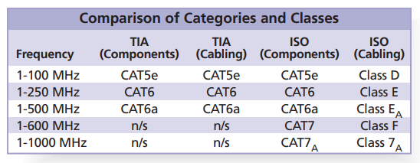
Copper Cable

Slide 4
Maps

Slide 5

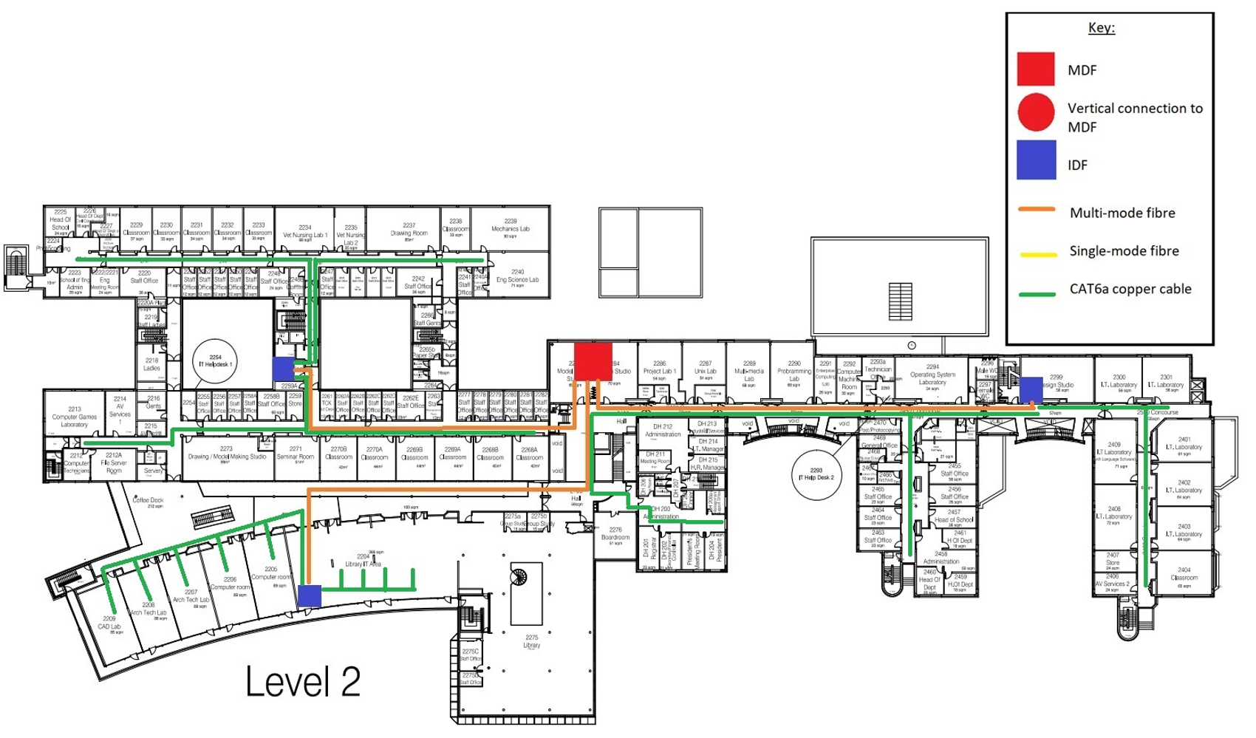
Main Building - Level 2
Central MDF
3 IDFs
Serving 1,766 connections
IDF1(342) + IDF2 (566) + IDF3(858)

Slide 6
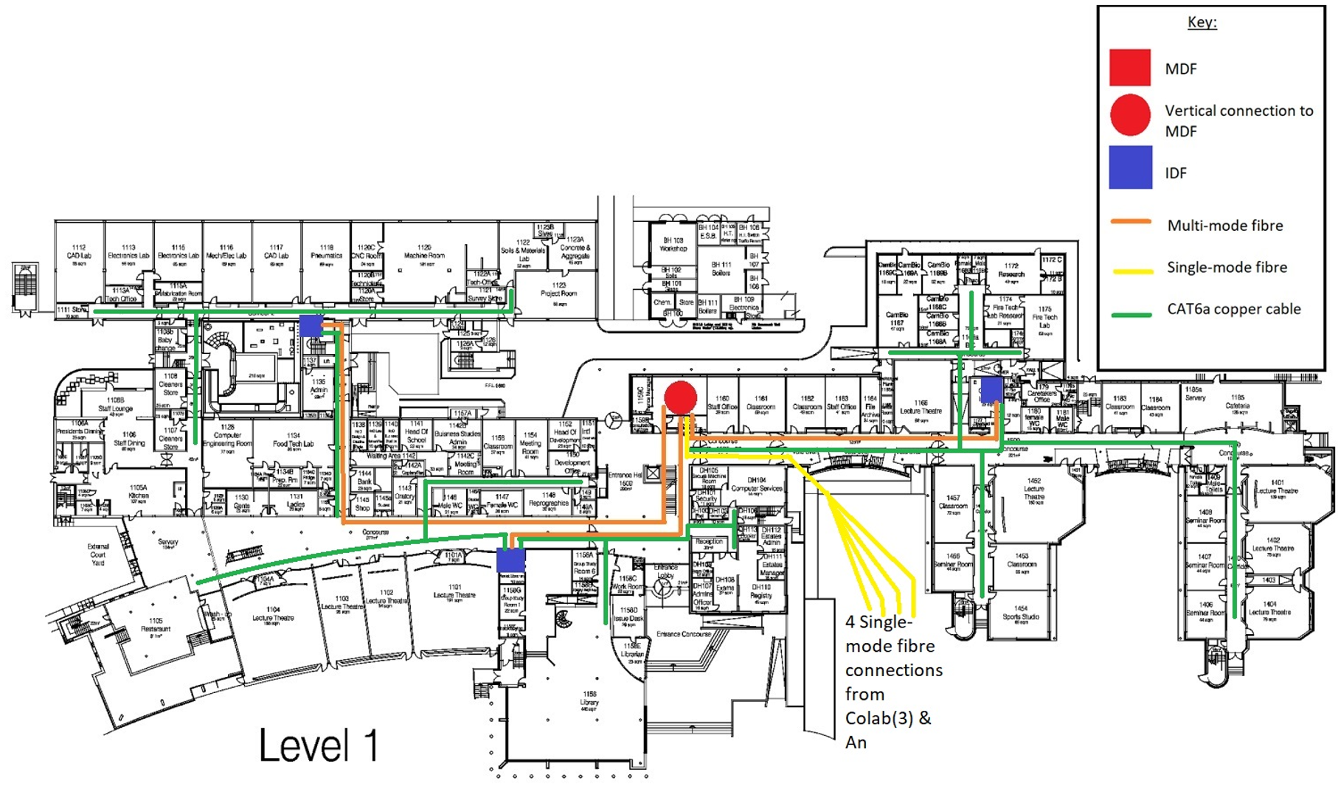
Main Building - Level 1
Central MDF
3 IDFs
Serving 750 connections
IDF1(400) + IDF2 (106) + IDF3(244)

Slide 7
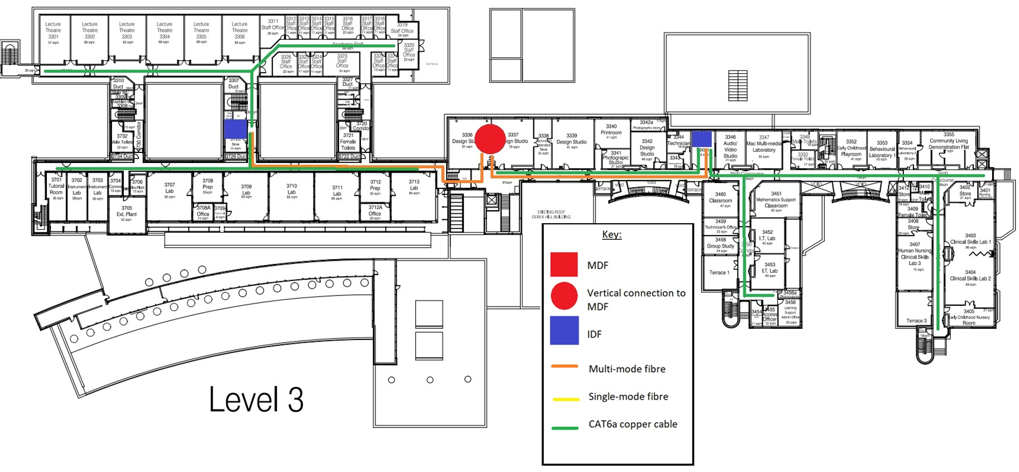
Main Building - Level 3
Central vertical connection to MDF
2 IDFs
Serving 256 connections
IDF1(75) + IDF2 (181)

Slide 8
Access points
Collision & Broadcast Domains
Access Points
250 Aruba AP-535 wireless routers.
ATU Letterkenny campus is 18,000m2.
Industry overlap of 10/15%.
Consider building plans, obstacles & interference.
VLANS
VLANS to separate broadcast domains limiting the members of the VLAN to the broadcast domain.
Switches
Microsegmentation.
The microsegmentation performed by the switches we have employed, results in the reduction of collision domains.

Slide 9
Hardware

Slide 10
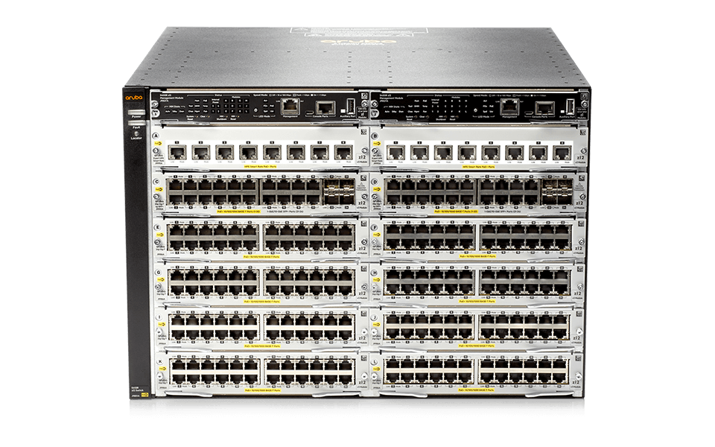
Edge Switches - Aruba 5412R zl2
Virtual Switching Framework (VSF)
- Simplifies network topology
- Outperforms traditional stacking in management and resiliency
OpenFlow Support
- Surpasses basic SDN capabilities of competitors
Unmatched Lifetime Warranty
- Next-business-day hardware replacement

Slide 11
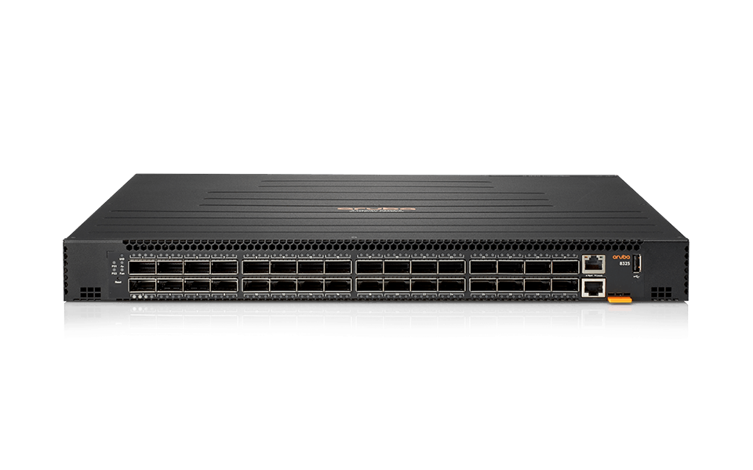
Core Switches - Aruba 8325
Multi-Gigabit Ethernet Support
- Up to 100Gbps interfaces
- ArubaOS-CX
- Fully programmable network operating system
- Automation exceeds competitors
- Deep Packet Inspection
- Enhances network visibility for advanced analytics

Slide 12
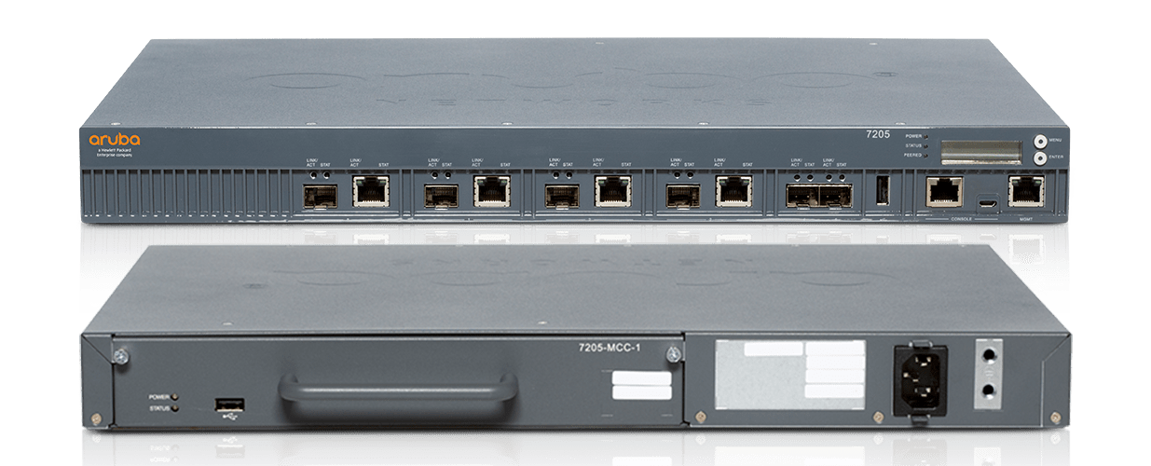
Routers - Aruba 7205
Multi-Core CPU Architecture
- High-speed cryptographic performance
- Outperforms competitor router CPUs
Policy Enforcement Firewall (PEF)
- Dynamic role-based security enforcement
Zero-Touch Provisioning
- Rapid deployment for efficiency

Slide 13
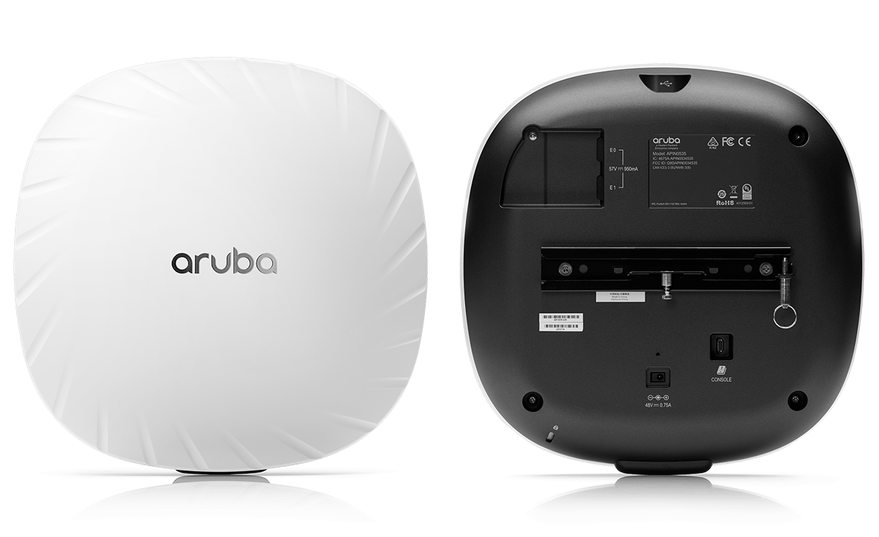
Access Points - Aruba AP-535
OFDMA Technology
- Efficient data transmission with Wi-Fi 6
Target Wake Time (TWT)
- Extends device battery life
Layer 7 Traffic Classification
- Intelligent application recognition

Slide 14
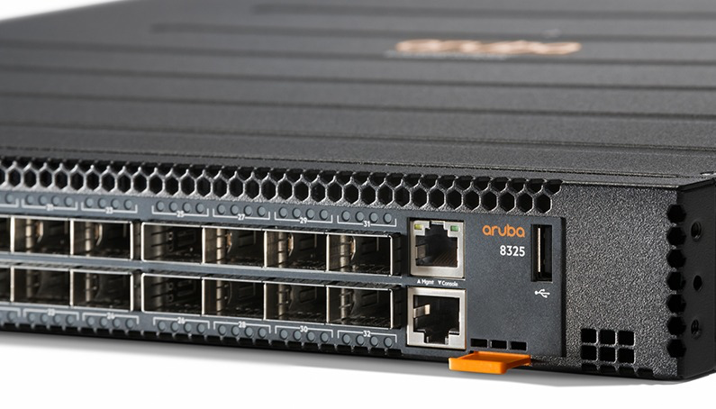
Hardware Requirements and Conclusion
Core Switches: 4 Aruba 8325 with QSFP28 ports for 100Gbps
Edge Switches: 20 Aruba 5400R zl2 switches with 1Gbps and 10Gbps ports
Routing Infrastructure: Aruba 7205 Series router for high-performance routing and security
Wireless Access: 230 Aruba AP-535 units for comprehensive Wi-Fi 6 coverage

Slide 15
Internal Servers and Services

Slide 16
Servers/Services
File Servers.
Application Servers.
Web Servers.
Print Servers.

Slide 17
Servers/Services
NTP
DNS
DHCP
SSH
Proxy

Slide 18
Servers/Services
Why are these servers/services important?
How will they be stored?

Slide 19
Subnetting and VLANs

Slide 20
I want only one router
- VLAN per purpose (An Danlann, Wi-Fi, Lecturers, Colab, Technicians, Printers, Medical Centre, Killybegs, Admin Staff, Servers)
- Next gen firewall

Slide 21
Subnets
Network Address | From | To | Broadcast | Purpose
172.16.0.0/20 | 172.16.0.1/20 | 172.16.15.254/20 | 172.16.15.255 | Classes
172.16.16.0/20 | 172.16.16.1/20 | 172.16.31.254/20 | 172.16.31.255 | An Danlann
172.16.32.0/20 | 172.16.32.1/20 | 172.16.47.254/20 | 172.16.47.255 | Wi-Fi
172.16.48.0/20 | 172.16.48.1/20 | 172.16.63.254/20 | 172.16.63.255 | Lecturers
172.16.64.0/20 | 172.16.64.1/20 | 172.16.79.254/20 | 172.16.79.255 | Colab
172.16.80.0/20 | 172.16.80.1/20 | 172.16.95.254/20 | 172.16.95.255 | Technicians
172.16.96.0/20 | 172.16.96.1/20 | 172.16.111.254/20 | 172.16.111.255 | Printers
172.16.112.0/20 | 172.16.112.1/20 | 172.16.127.254/20 | 172.16.127.255 | Medical Centre
172.16.128.0/20 | 172.16.128.1/20 | 172.16.143.254/20 | 172.16.143.255 | Killybegs
172.16.144.0/20 | 172.16.144.1/20 | 172.16.159.254/20 | 172.16.159.255 | Admin Staff
172.16.160.0/20 | 172.16.160.1/20 | 172.16.175.254/20 | 172.16.175.255 | Servers
“I want a router per IDF”
Resource Isolation

Slide 22
WAN links
WAN network address | WAN address MDF | WAN address IDF | WAN Broadcast | WAN purpose
172.16.0.0/30 | 172.16.0.1/30 | 172.16.0.2/30 | 172.16.0.3 | Business, Education, Design
172.16.0.4/30 | 172.16.0.5/30 | 172.16.0.6/30 | 172.16.0.7 | Science, Health
172.16.0.8/30 | 172.16.0.9/30 | 172.16.0.10/30 | 172.16.0.11 | Engineering, Technology
172.16.16.0/30 | 172.16.16.1/30 | 172.16.16.2/30 | 172.16.16.3 | An Danlann
172.16.32.0/30 | 172.16.32.1/30 | 172.16.32.2/30 | 172.16.32.3 | Student, Staff Wi-Fi
172.16.32.4/30 | 172.16.32.5/30 | 172.16.32.6/30 | 172.16.32.7 | Guest Wi-Fi
172.16.48.0/30 | 172.16.48.1/30 | 172.16.48.2/30 | 172.16.48.3 | Lecturers
172.16.64.0/30 | 172.16.64.1/30 | 172.16.64.2/30 | 172.16.64.3 | Colab
172.16.80.0/30 | 172.16.80.1/30 | 172.16.80.2/30 | 172.16.80.3 | Technicians
172.16.96.0/30 | 172.16.96.1/30 | 172.16.96.2/30 | 172.16.96.3 | Printers
172.16.112.0/30 | 172.16.112.1/30 | 172.16.112.2/30 | 172.16.112.3 | Medical Centre
172.16.128.0/30 | 172.16.128.1/30 | 172.16.128.2/30 | 172.16.128.3 | Killybegs
172.16.144.0/30 | 172.16.144.1/30 | 172.16.144.2/30 | 172.16.144.3 | Admin Staff
172.16.160.0/30 | 172.16.160.1/30 | 172.16.160.2/30 | 172.16.160.3 | Servers DMZ
“I want a router per IDF”
Connections between routers

Slide 23
Security

Slide 24
Next gen Firewalls
Packet filtering
Application awareness and control
Signature detection
Statistical anomaly detection
Stateful protocol analysis detection

Slide 25
Wi-fi authentication
- EAP
- NAC verification

Slide 26
802.1X
- Authorising the supplicants by using a RADIUS (Remote Authentication Dial-In User Service) server
- Support for EAP-TLS, PEAP, and EAP-MSCHAPv2
- Logging

Slide 27
VPN
- IPSec and SSL/TLS
- Remote access
- Multi Factor Authentication

Slide 28
NAC
- Restrict access to networks based on policies
- Enforcement points
- RADIUS server for authentication

Slide 29
Antivirus software
- Microsoft Defender
- Azure Security Dashboard

Slide 30
Zero-trust policies
- Azure Security Centre
- No user besides the Administrators should be allowed to run any software as Administrator to avoid any kind of malware from having system permissions
- Any windows events such as user program installs, Antivirus detections or any other malicious activity should be notified to the SOC team to analyse and take actions

Slide 31
email
- SSL/TLS
- SPF records

Slide 32
Authentication key storage
- Azure Key Vault

Slide 33
Internal asset access
Teachers may need to access private data. To assure that only the authorised people can access the data, they must connect through the VPN to access these resources.

Slide 34
Software installation across devices
All systems will be provided a copy of Microsoft Software centre. In here, only software that has been authorized beforehand by Administrators will be allowed to be installed and allow Administrators to install software to multiple computers remotely if they desire.

Slide 35
Conclusion

